Slide 1
GRADE 7 ACCELERATED · UNIT 6 · THREAD B · DAY 2
Interior and Exterior Angles of a Triangle
MA.8.GR.1.5
I can find a missing angle of a triangle, inside or outside, with the Triangle Sum and the Exterior Angle Theorem.
Grade 7 Accelerated · Unit 6 · Thread B · Day 2 — Interior and Exterior Angles of a Triangle
1

Slide 2


Warm-Up
1. What is the supplement of 83°?
2. How far apart are
and
?
3. 12 pens cost $9. What does one pen cost?
4. A straight angle is split into 50°, 60° and x°. Find x.
Grade 7 Accelerated · Unit 6 · Thread B · Day 2 — Interior and Exterior Angles of a Triangle
2

Slide 3
Warm-Up
1. What is the supplement of 83°?
97°
2. How far apart are
and
?
10 units
3. 12 pens cost $9. What does one pen cost?
$0.75
4. A straight angle is split into 50°, 60° and x°. Find x.
70
Grade 7 Accelerated · Unit 6 · Thread B · Day 2 — Interior and Exterior Angles of a Triangle
3

Slide 4
Vocabulary
interior angle
an angle inside a triangle, at one of its corners
exterior angle
the angle between one side of a triangle and the next side extended; it makes a linear pair with the interior angle beside it
remote interior angles
the two interior angles that are not beside a given exterior angle
Triangle Sum Theorem
the three interior angles of a triangle add to 180°
Grade 7 Accelerated · Unit 6 · Thread B · Day 2 — Interior and Exterior Angles of a Triangle
4

Slide 5
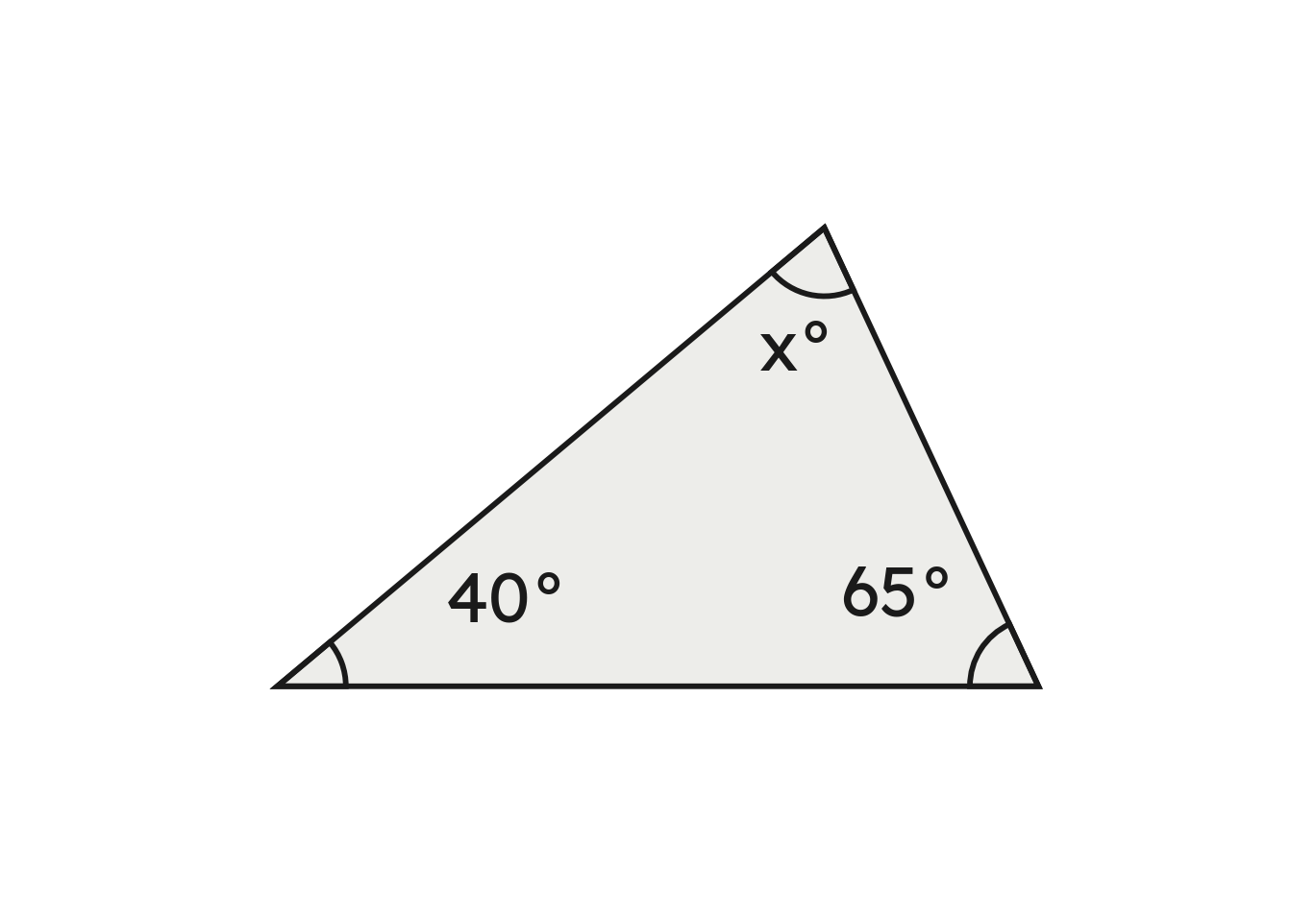

Notes
I. The Triangle Sum: the three angles make 180°
,
A triangle's three angles add to 180°:
Grade 7 Accelerated · Unit 6 · Thread B · Day 2 — Interior and Exterior Angles of a Triangle
5

Slide 6
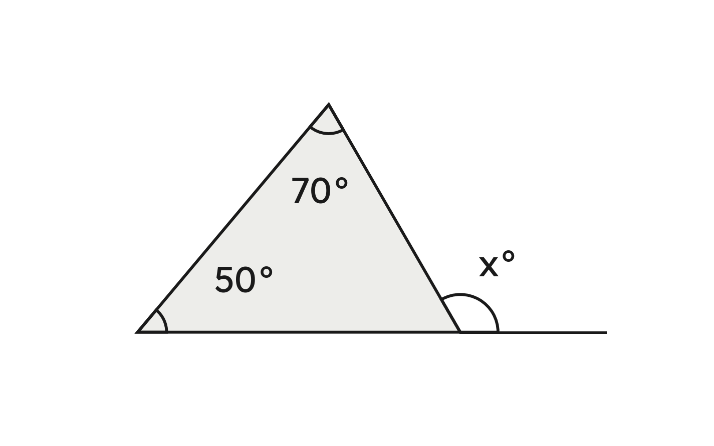

Notes
II. The Exterior Angle Theorem: outside = the two remote angles
check:
Not the angle beside it, and not the angle around the outside.
Grade 7 Accelerated · Unit 6 · Thread B · Day 2 — Interior and Exterior Angles of a Triangle
6

Slide 7
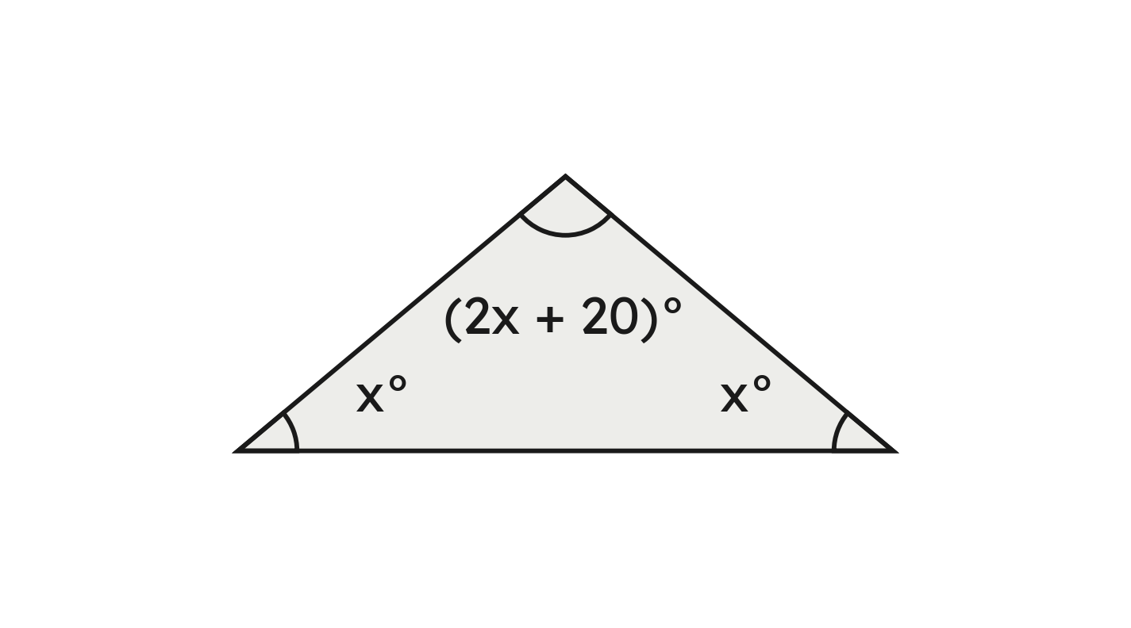




Notes
III. Angles as expressions
,
,
the angles:
,
,
Grade 7 Accelerated · Unit 6 · Thread B · Day 2 — Interior and Exterior Angles of a Triangle
7

Slide 8


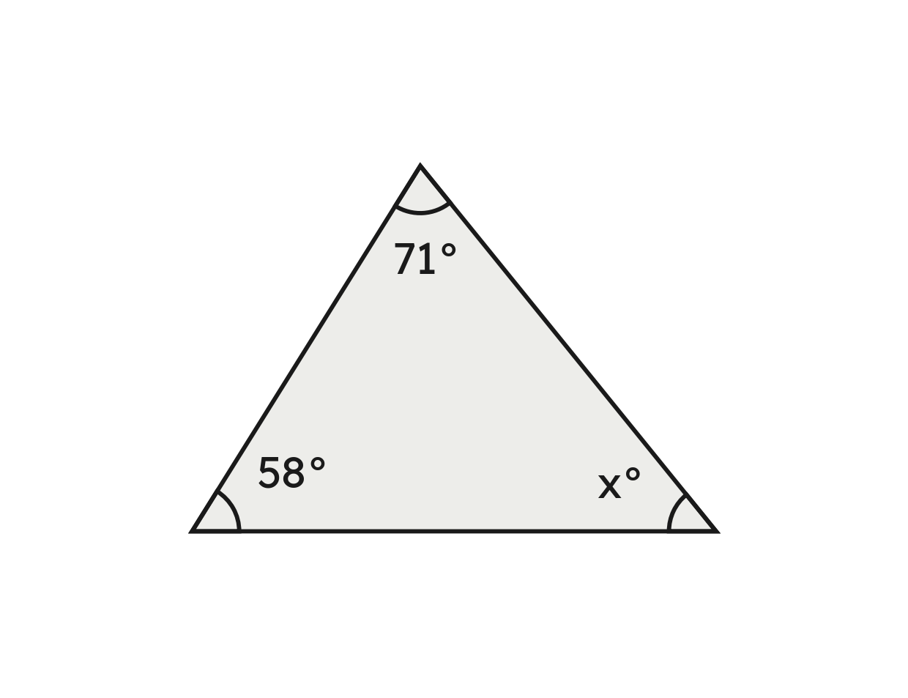
Example 1
Two angles of a triangle are
and
.
Find the third angle.
Grade 7 Accelerated · Unit 6 · Thread B · Day 2 — Interior and Exterior Angles of a Triangle
8

Slide 9

Example 1
Answer: The third angle is 51°.
Grade 7 Accelerated · Unit 6 · Thread B · Day 2 — Interior and Exterior Angles of a Triangle
9

Slide 10


Your Turn
Two angles of a triangle are
and
.
Find the third angle.
Grade 7 Accelerated · Unit 6 · Thread B · Day 2 — Interior and Exterior Angles of a Triangle
10

Slide 11




Your Turn
Two angles of a triangle are
and
.
Find the third angle.
Answer: 57°
Grade 7 Accelerated · Unit 6 · Thread B · Day 2 — Interior and Exterior Angles of a Triangle
11

Slide 12


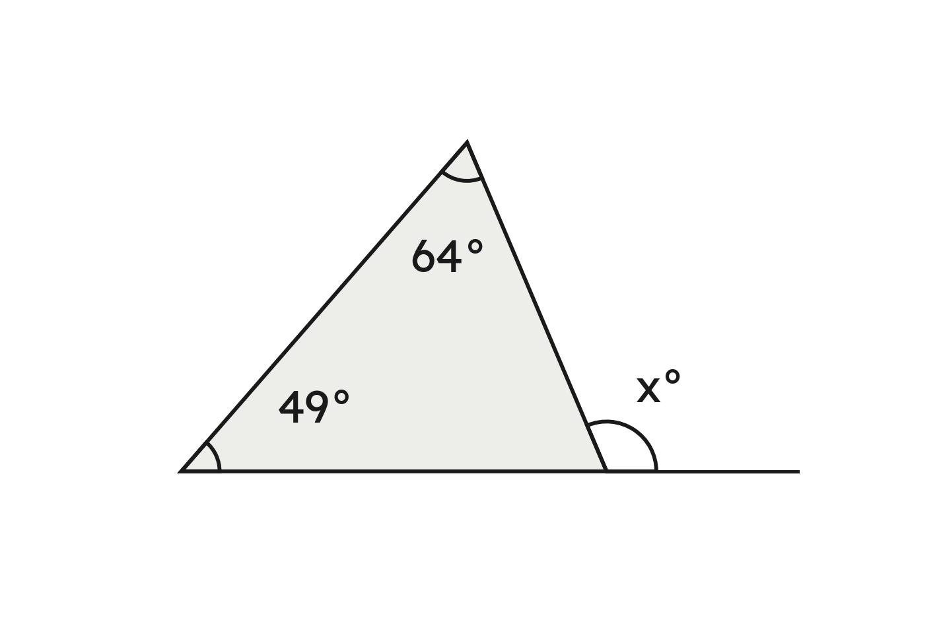
Example 2
A triangle's remote interior angles are
and
.
Find the exterior angle x.
Grade 7 Accelerated · Unit 6 · Thread B · Day 2 — Interior and Exterior Angles of a Triangle
12

Slide 13

Example 2
Answer: The exterior angle is 113°.
Grade 7 Accelerated · Unit 6 · Thread B · Day 2 — Interior and Exterior Angles of a Triangle
13

Slide 14


Your Turn
A triangle's remote interior angles are
and
.
Find the exterior angle.
Grade 7 Accelerated · Unit 6 · Thread B · Day 2 — Interior and Exterior Angles of a Triangle
14

Slide 15


Your Turn
A triangle's remote interior angles are
and
.
Find the exterior angle.
Answer: 107°
Grade 7 Accelerated · Unit 6 · Thread B · Day 2 — Interior and Exterior Angles of a Triangle
15

Slide 16
Whiteboards · Question 1 of 9
Two angles of a triangle are 47° and 68°. Find the third angle.
Answer it.
Grade 7 Accelerated · Unit 6 · Thread B · Day 2 — Interior and Exterior Angles of a Triangle
16

Slide 17


Whiteboards · Question 1 of 9
Two angles of a triangle are 47° and 68°. Find the third angle.
Answer: 65°
Grade 7 Accelerated · Unit 6 · Thread B · Day 2 — Interior and Exterior Angles of a Triangle
17

Slide 18
Whiteboards · Question 2 of 9
An isosceles triangle's two base angles are equal. Each is 52°.
Find the third angle.
Answer it.
Grade 7 Accelerated · Unit 6 · Thread B · Day 2 — Interior and Exterior Angles of a Triangle
18

Slide 19


Whiteboards · Question 2 of 9
An isosceles triangle's two base angles are equal. Each is 52°.
Find the third angle.
Answer: 76°
Grade 7 Accelerated · Unit 6 · Thread B · Day 2 — Interior and Exterior Angles of a Triangle
19

Slide 20
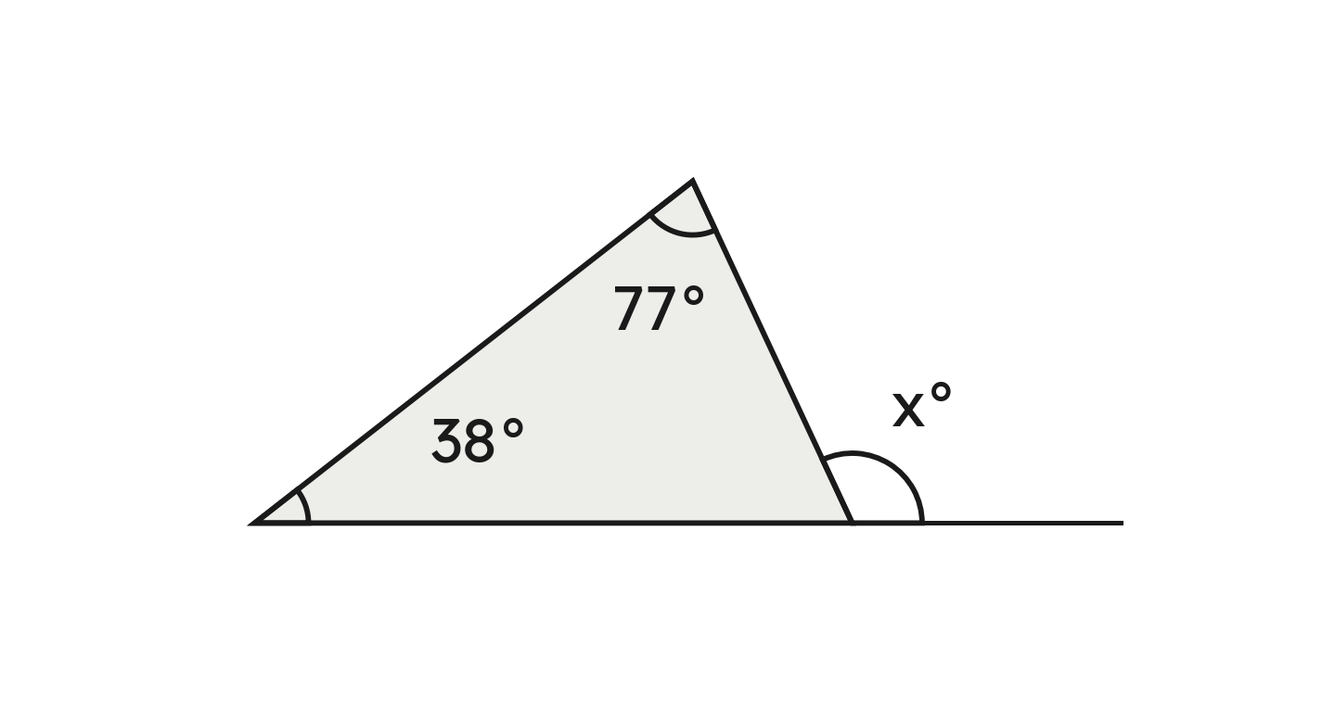
Whiteboards · Question 3 of 9
A triangle's remote interior angles are 38° and 77°.
Find the exterior angle x.
Answer it.
Grade 7 Accelerated · Unit 6 · Thread B · Day 2 — Interior and Exterior Angles of a Triangle
20

Slide 21

Whiteboards · Question 3 of 9
A triangle's remote interior angles are 38° and 77°.
Find the exterior angle x.
Answer: 115°
Grade 7 Accelerated · Unit 6 · Thread B · Day 2 — Interior and Exterior Angles of a Triangle
21

Slide 22
Whiteboards · Question 4 of 9
A triangle's angles are 45°, 60° and 75°.
What is the exterior angle beside the 75°?
A. 75°
B. 105°
C. 285°
D. 60°
Answer it.
Grade 7 Accelerated · Unit 6 · Thread B · Day 2 — Interior and Exterior Angles of a Triangle
22

Slide 23


Whiteboards · Question 4 of 9
A triangle's angles are 45°, 60° and 75°.
What is the exterior angle beside the 75°?
check:
Answer: B — 105°
Grade 7 Accelerated · Unit 6 · Thread B · Day 2 — Interior and Exterior Angles of a Triangle
23

Slide 24
Whiteboards · Question 5 of 9
An exterior angle of a triangle is 130°. One remote interior angle is 55°.
Find the other remote interior angle.
Answer it.
Grade 7 Accelerated · Unit 6 · Thread B · Day 2 — Interior and Exterior Angles of a Triangle
24

Slide 25


Whiteboards · Question 5 of 9
An exterior angle of a triangle is 130°. One remote interior angle is 55°.
Find the other remote interior angle.
Answer: 75°
Grade 7 Accelerated · Unit 6 · Thread B · Day 2 — Interior and Exterior Angles of a Triangle
25

Slide 26



Whiteboards · Question 6 of 9
A triangle's angles are
,
and
.
Find each angle.
Answer it.
Grade 7 Accelerated · Unit 6 · Thread B · Day 2 — Interior and Exterior Angles of a Triangle
26

Slide 27






Whiteboards · Question 6 of 9
A triangle's angles are
,
and
.
Find each angle.
,
,
,
Answer: 28°, 84° and 68°
Grade 7 Accelerated · Unit 6 · Thread B · Day 2 — Interior and Exterior Angles of a Triangle
27

Slide 28





Whiteboards · Question 7 of 9
An exterior angle measures
.
Its remote interior angles measure
and
.
Which equation finds x?
A.
B.
C.
D.
Answer it.
Grade 7 Accelerated · Unit 6 · Thread B · Day 2 — Interior and Exterior Angles of a Triangle
28

Slide 29




Whiteboards · Question 7 of 9
An exterior angle measures
.
Its remote interior angles measure
and
.
Which equation finds x?
outside = the two far ones: 5x + 4 = 52 + 3x
,
Answer: C — 5x + 4 = 52 + 3x
Grade 7 Accelerated · Unit 6 · Thread B · Day 2 — Interior and Exterior Angles of a Triangle
29

Slide 30
Whiteboards · Question 8 of 9
A triangle has angles of 41° and 66°, and its longest side is 9 cm.
Find its third angle.
Answer it.
Grade 7 Accelerated · Unit 6 · Thread B · Day 2 — Interior and Exterior Angles of a Triangle
30

Slide 31


Whiteboards · Question 8 of 9
A triangle has angles of 41° and 66°, and its longest side is 9 cm.
Find its third angle.
Answer: 73°
Grade 7 Accelerated · Unit 6 · Thread B · Day 2 — Interior and Exterior Angles of a Triangle
31

Slide 32
Whiteboards · Question 9 of 9
Why is an exterior angle always bigger than either remote interior angle?
Write your answer in sentences.
Grade 7 Accelerated · Unit 6 · Thread B · Day 2 — Interior and Exterior Angles of a Triangle
32

Slide 33

Whiteboards · Question 9 of 9
Why is an exterior angle always bigger than either remote interior angle?
for example:
, more than 40 and more than 65
Answer: It is the two remote angles added, each more than 0°.
Grade 7 Accelerated · Unit 6 · Thread B · Day 2 — Interior and Exterior Angles of a Triangle
33

Slide 34





Independent Set
1.
Two angles of a triangle are 63° and 79°. Find the third angle.
2.
An isosceles triangle's two base angles are equal. The angle between its
two equal sides is 40°. Find each base angle.
3.
A triangle's remote interior angles are 46° and 58°. Find the exterior angle.
4.
An exterior angle of a triangle is 140°. One remote interior angle is 62°.
Find the other.
5.
A triangle's angles are
,
and
. Find each angle.
6.
An exterior angle of a triangle measures
; its remote interior
angles measure
and
. Write an equation and find x.
Grade 7 Accelerated · Unit 6 · Thread B · Day 2 — Interior and Exterior Angles of a Triangle
34

Slide 35
IXL
1.
Open IXL and start today's skills.
2.
Work on paper where the question needs work. The answer box does not show it.
3.
Every skill listed is required, to a SmartScore of 67. Due at the start of the next class.
Today's skills — all required
Find missing angles in triangles — JFJ
Exterior Angle Theorem — FMP
Triangle Angle-Sum Theorem — 6Q6
Grade 7 Accelerated · Unit 6 · Thread B · Day 2 — Interior and Exterior Angles of a Triangle
35

